Slide 1
Binocular Rivalry in VR
Nicholas, Leif, Matthew, Caleb, Isaac

Slide 2
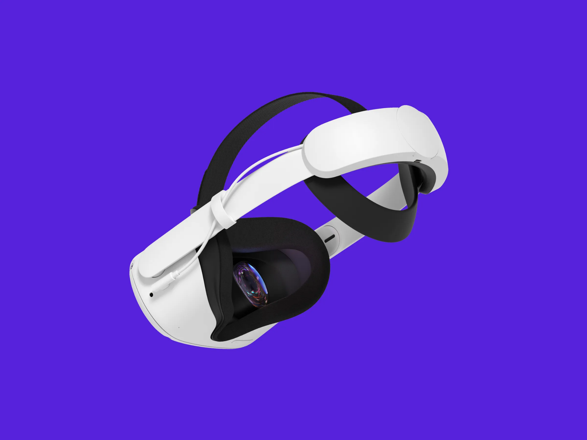
Project Description and Objective
The objective of our project was to port the long-standing field of binocular rivalry research into a virtual reality environment.
The use of a VR binocular rivalry test would reduce the external distractions that subjects may be exposed to during testing.
These distractions could potentially affect the accuracy and the speed of data which the user would be providing during testing.
Source: (1)

Slide 3
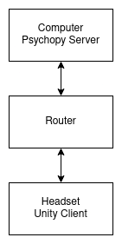
Project Software Design
Focused on displaying the images to each eye
Individual images will be shown to each eye to produce binocular rivalry
Designed to control the project from the computer
Minimizes resources demanded by the headset
Most data processing is handled on the computer
Designed with a Client/Server Architecture
Utilizes sockets to communicate

Slide 4
Software/Resources
Hardware
The Meta Quest 2 virtual reality headsets were used during development.
Unity
Unity was used as a basis for creating and testing a virtual environment that could project a binocular rivalry experiment into the headset efficiently.
PsychoPy
PsychoPy was used as the platform in which the gabor patches were created and tested and user input was recorded.
Coding languages
C#
C++
Python

Slide 5
Challenges and Difficulties
Understanding Unity
Due to the scope of Unity’s software capabilities, it took our team some time to become acclimated. This was solved quickly as our scope of usage within Unity was limited in nature. The biggest hurdle was getting a clear connection with the C# files.
Learning PsychoPy
PsychoPy is the software standard for binocular rivalry software testing. Our team took an extensive period of time to learn the software and its capabilities. What we learned is that it functions well on its own and not with other programs.
Display Issues with PsychoPy
PsychoPy has very little in the way of display control, even with additional monitors being connected. Our original plan was to try and connect the headset to the list of displays within PsychoPy. This largely proved to be a failure as there is virtually no way to add additional displays besides the primary display.

Slide 6
Challenges and Difficulties Continued
Socket Compatibility
After the initial plan of connecting the headset as a secondary display to PsychoPy failed, our team switched to connecting a socket between two computers and the headset. The first computer would run a test within Unity and the second computer would connect and display that image to the headset. Additionally, eduroam seems to have a firewall that blocks socket connection.
Unity and PsychoPy Compatibility Issues
There is limited documentation on how to connect Unity to a PsychoPy test. There was also an ongoing project by developers to improve compatibility, but it was never finished. The two softwares largely failed to establish a connection which limited our ability to display a gabor patch test within a Unity environment.
Splitting Images Between Eyes
PsychoPy doesn't have the capacity to split the view between eyes when running a test.
Socket to VR Connection

Slide 7
Looking Forward
Ability to load images from PsychoPy in to the headset.
Ability to change images until the experiment is over
Stronger connection that allows for more dynamic use of project
Develop a method of communication that is not blocked by eduroam.
Connection with EEG

Slide 8
Questions?

Slide 9
Citations
Source (1): https://www.google.com/url?sa=i&url=https%3A%2F%2Fwww.wired.com%2Freview%2Foculus-quest-2-review%2F&psig=AOvVaw05OUnWpQbvlJmR7LBqOKSH&ust=1714769427395000&source=images&cd=vfe&opi=89978449&ved=0CBIQjRxqFwoTCNi2hq_s74UDFQAAAAAdAAAAABAE

